Slide 1
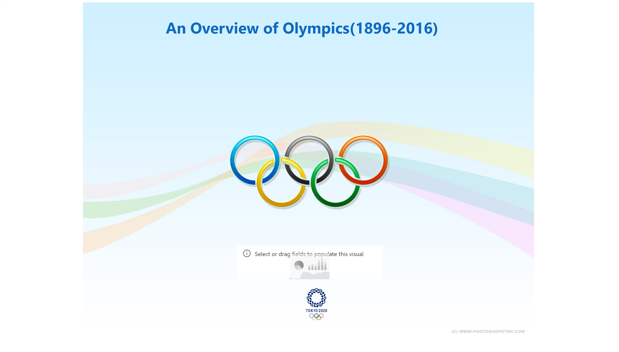
Intro
Notes:
countdownFA24FE5944D34ADD929D0DAE6EE57D70
No alt text provided.
image
No alt text provided.
image
No alt text provided.
textbox
No alt text provided.

Slide 2
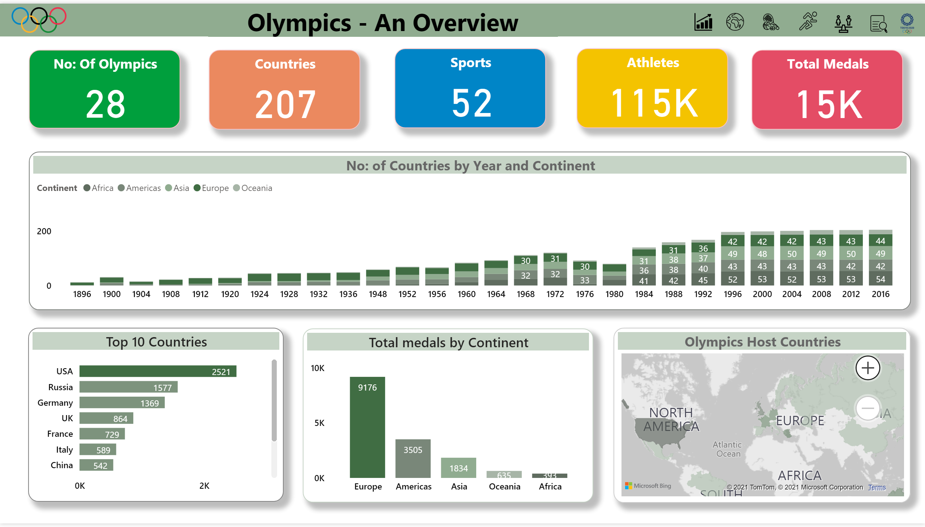
Overview
Notes:
Total medals by Continent
No alt text provided.
Olympics Host Countries
No alt text provided.
Top 10 Countries
No alt text provided.
No: of Countries by Year and Continent
No alt text provided.
Countries
No alt text provided.
Athletes
No alt text provided.
Total Medals
No alt text provided.
Sports
No alt text provided.
No: Of Olympics
No alt text provided.
Image5
No alt text provided.
Image6
No alt text provided.
Image4
No alt text provided.
Image2
No alt text provided.
Image3
No alt text provided.
image
No alt text provided.
Overall Medal Count
No alt text provided.
Imageolympics
No alt text provided.
textbox
No alt text provided.
Image5
No alt text provided.
Image6
No alt text provided.
Image4
No alt text provided.
Image2
No alt text provided.
Image3
No alt text provided.
image
No alt text provided.
Olympics - An Overview
No alt text provided.
Imageolympics
No alt text provided.
textbox
No alt text provided.
image
No alt text provided.

Slide 3
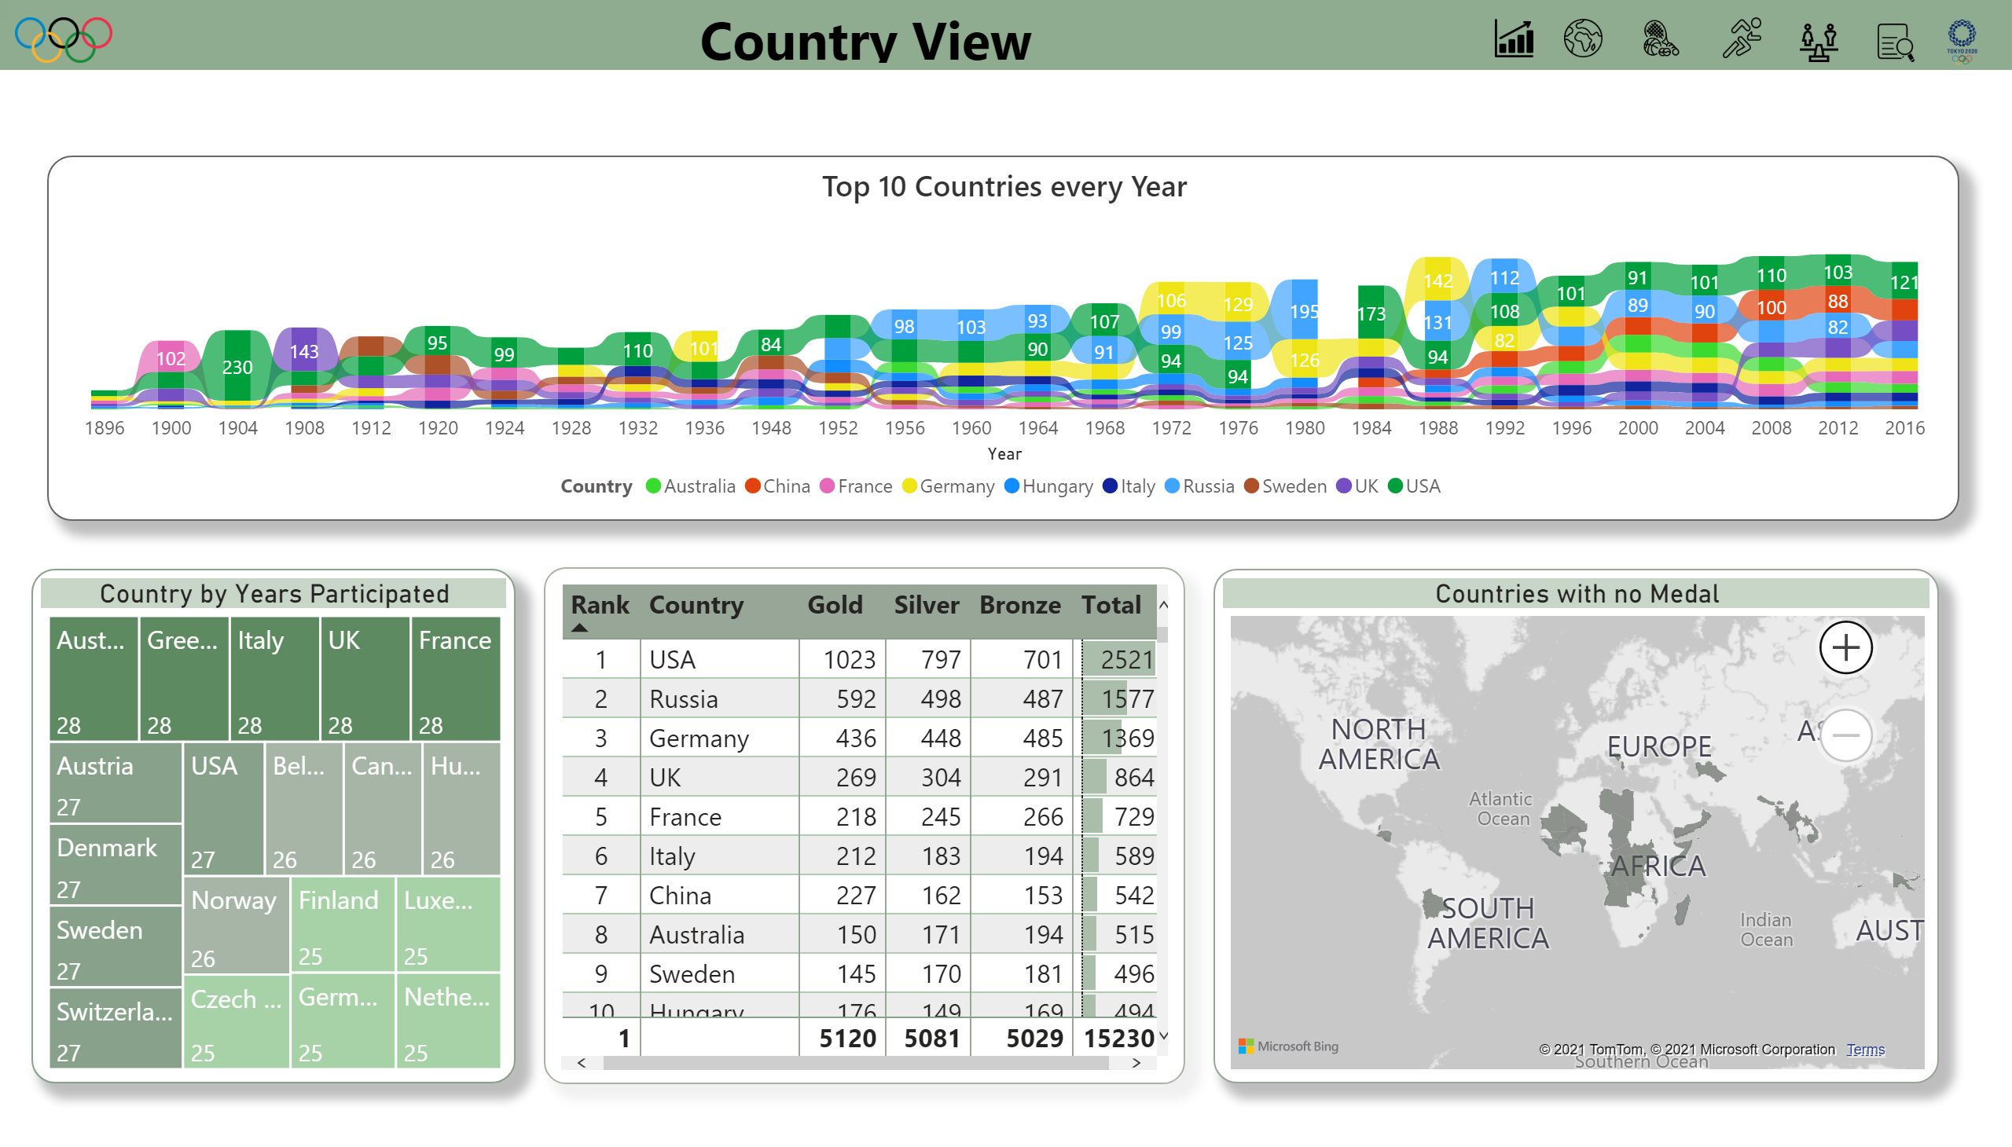
Country
Notes:
Countries with no Medal
No alt text provided.
Top 10 Countries every Year
No alt text provided.
Country by Years Participated
No alt text provided.
tableEx
No alt text provided.
Image5
No alt text provided.
Image6
No alt text provided.
Image4
No alt text provided.
Image2
No alt text provided.
Image3
No alt text provided.
image
No alt text provided.
Country View
No alt text provided.
Imageolympics
No alt text provided.
image
No alt text provided.
textbox
No alt text provided.

Slide 4
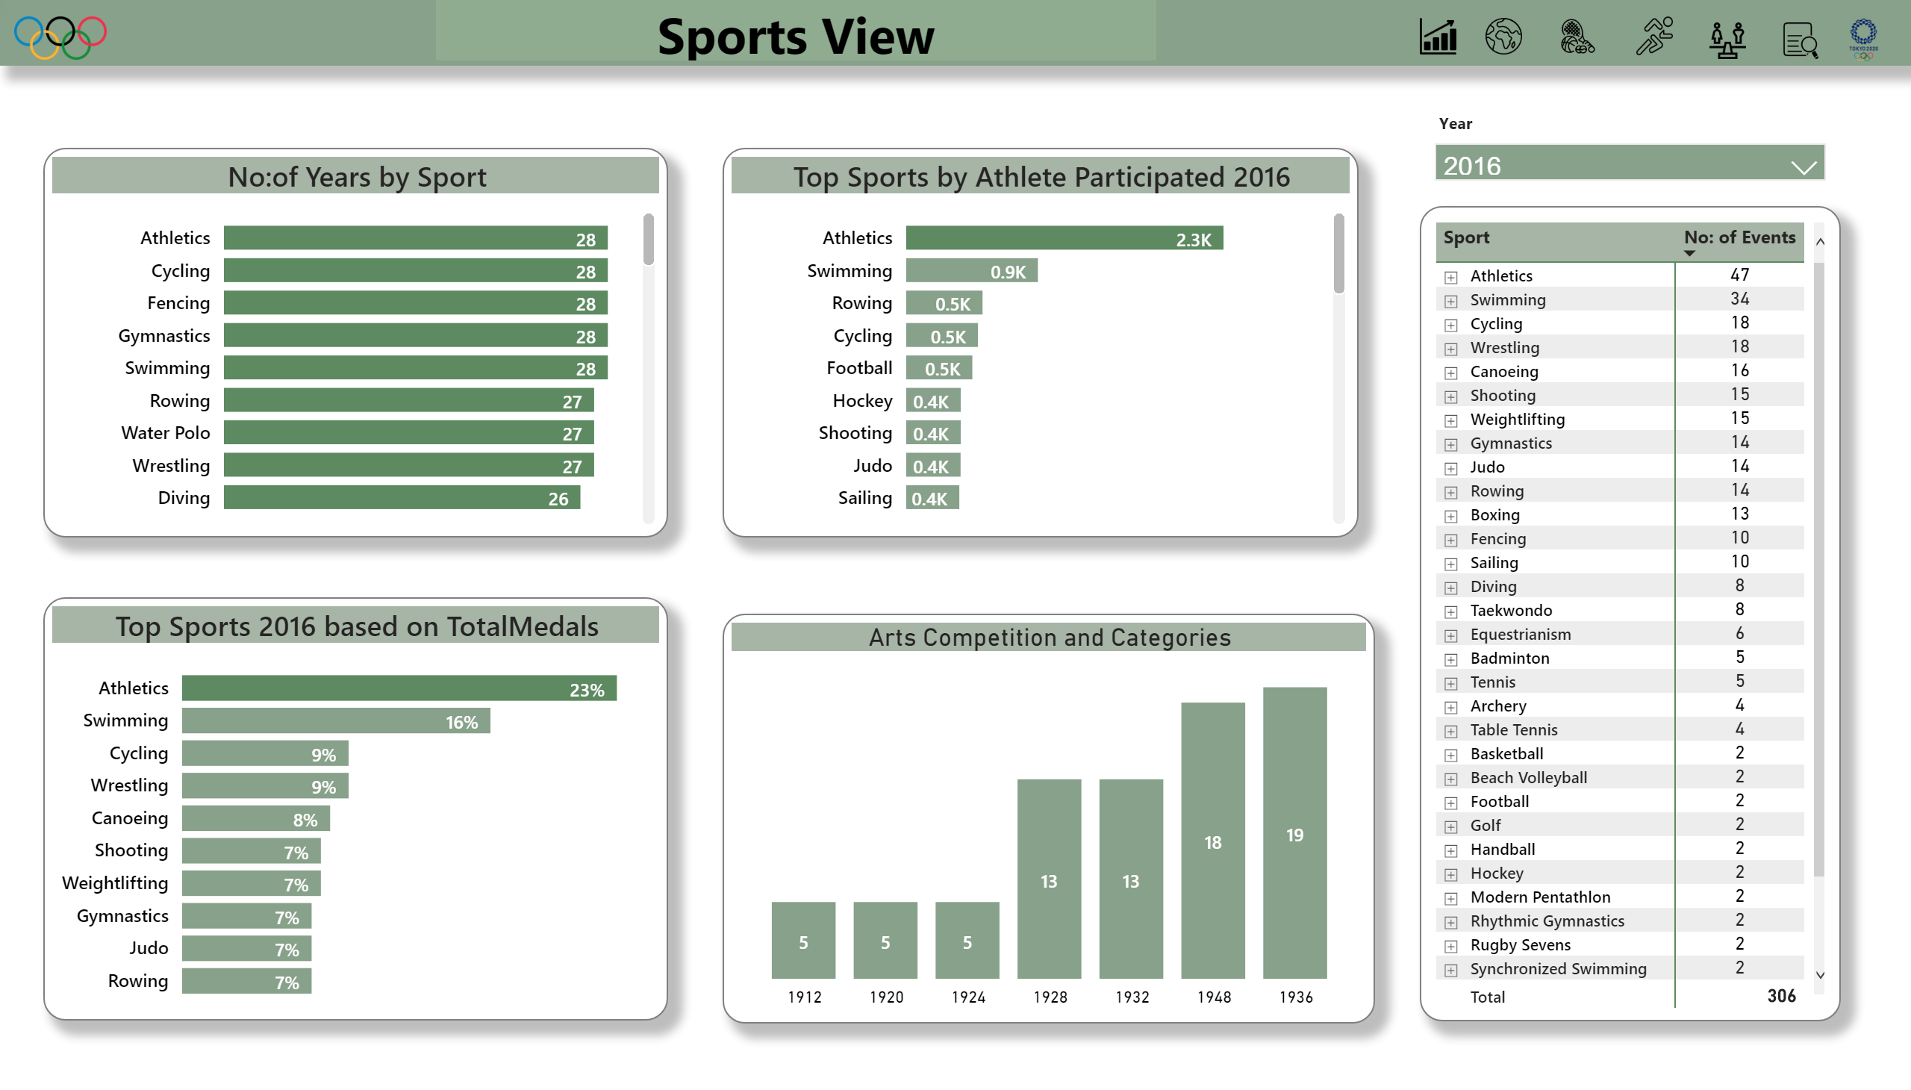
Sports
Notes:
pivotTable
No alt text provided.
Top Sports by Athlete Participated 2016
No alt text provided.
barChart
No alt text provided.
Top Sports 2016 based on TotalMedals
No alt text provided.
slicer
No alt text provided.
Image5
No alt text provided.
Image6
No alt text provided.
Image4
No alt text provided.
Image2
No alt text provided.
Image3
No alt text provided.
image
No alt text provided.
Sports View
No alt text provided.
Imageolympics
No alt text provided.
image
No alt text provided.
Arts Competition and Categories
No alt text provided.
textbox
No alt text provided.

Slide 5
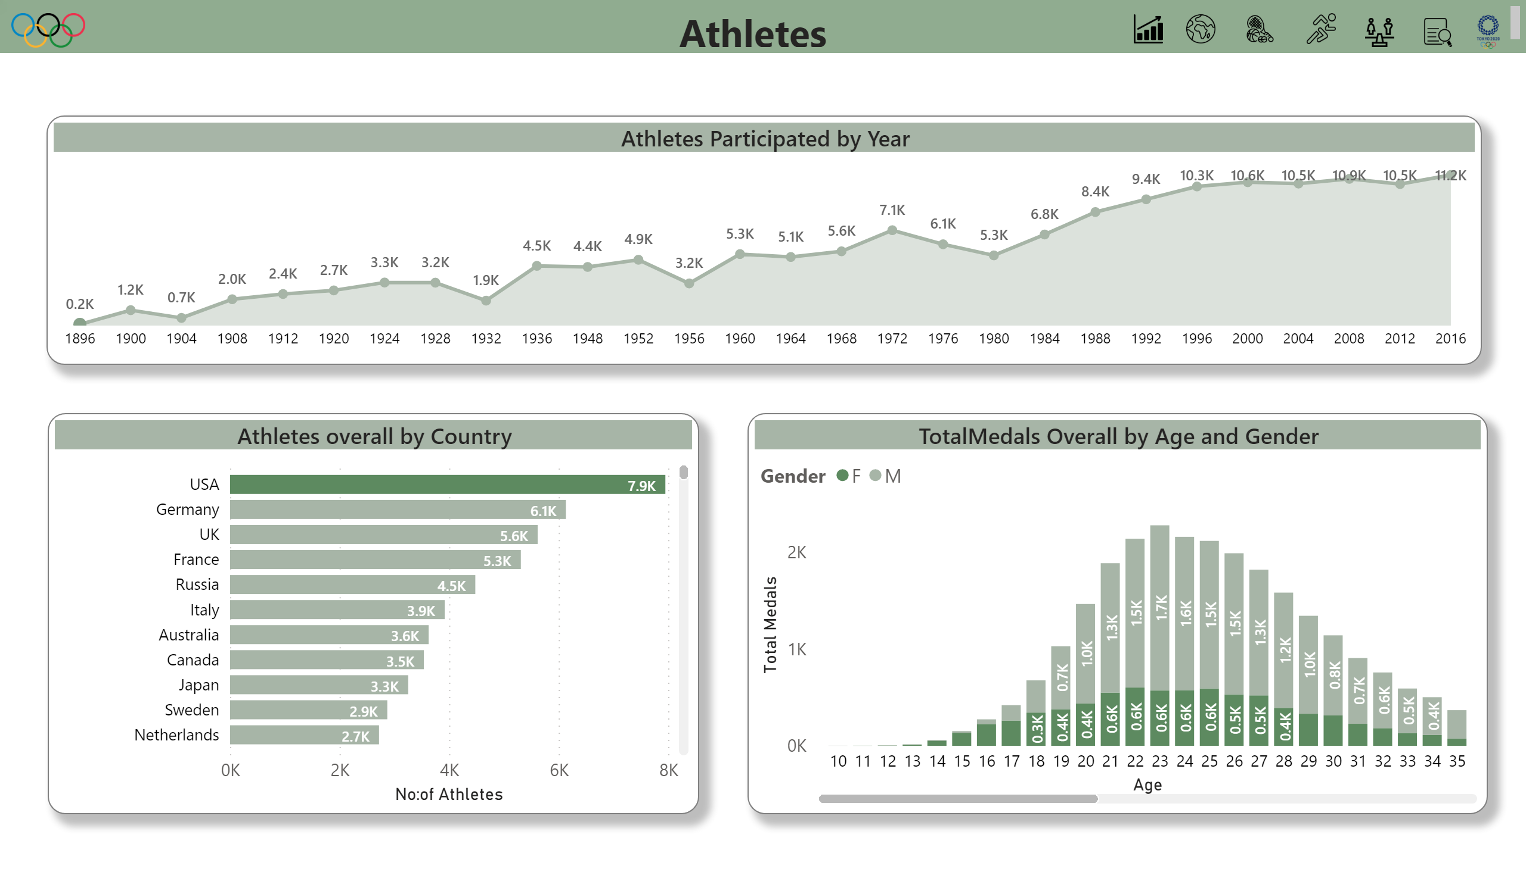
Athletes
Notes:
Athletes overall by Country
No alt text provided.
TotalMedals Overall by Age and Gender
No alt text provided.
Athletes Participated by Year
No alt text provided.
image
No alt text provided.
Image3
No alt text provided.
Imageolympics
No alt text provided.
Image2
No alt text provided.
image
No alt text provided.
Image4
No alt text provided.
Image5
No alt text provided.
Image6
No alt text provided.
textbox
No alt text provided.

Slide 6
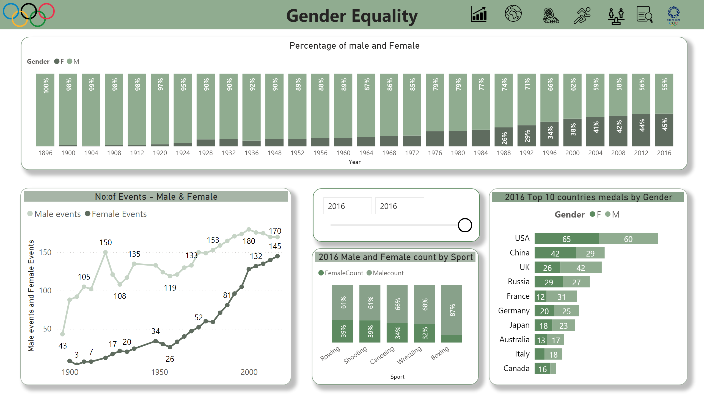
Gender Equality
Notes:
No:of Events - Male & Female
No alt text provided.
slicer
No alt text provided.
2016 Top 10 countries medals by Gender
No alt text provided.
Percentage of male and Female
No alt text provided.
2016 Male and Female count by Sport
No alt text provided.
shape
No alt text provided.
textbox
No alt text provided.
Image6
No alt text provided.
Image5
No alt text provided.
Image4
No alt text provided.
image
No alt text provided.
Imageolympics
No alt text provided.
Image2
No alt text provided.
Image3
No alt text provided.
image
No alt text provided.

Slide 7
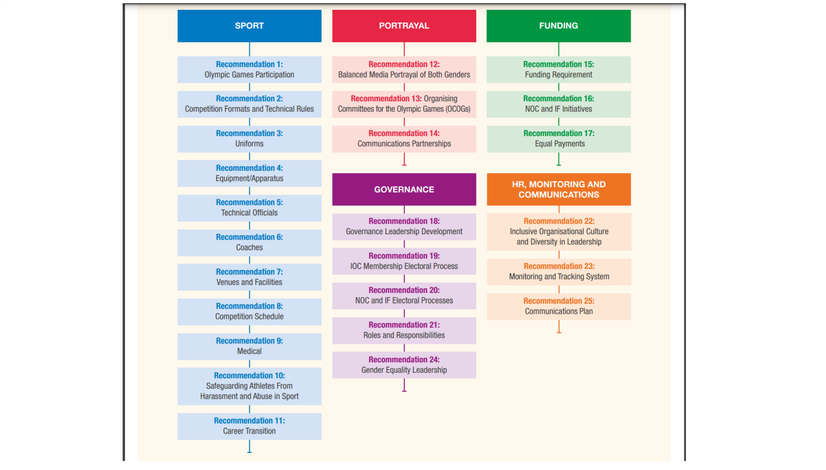
Recommendations
Notes:
image
No alt text provided.

Slide 8
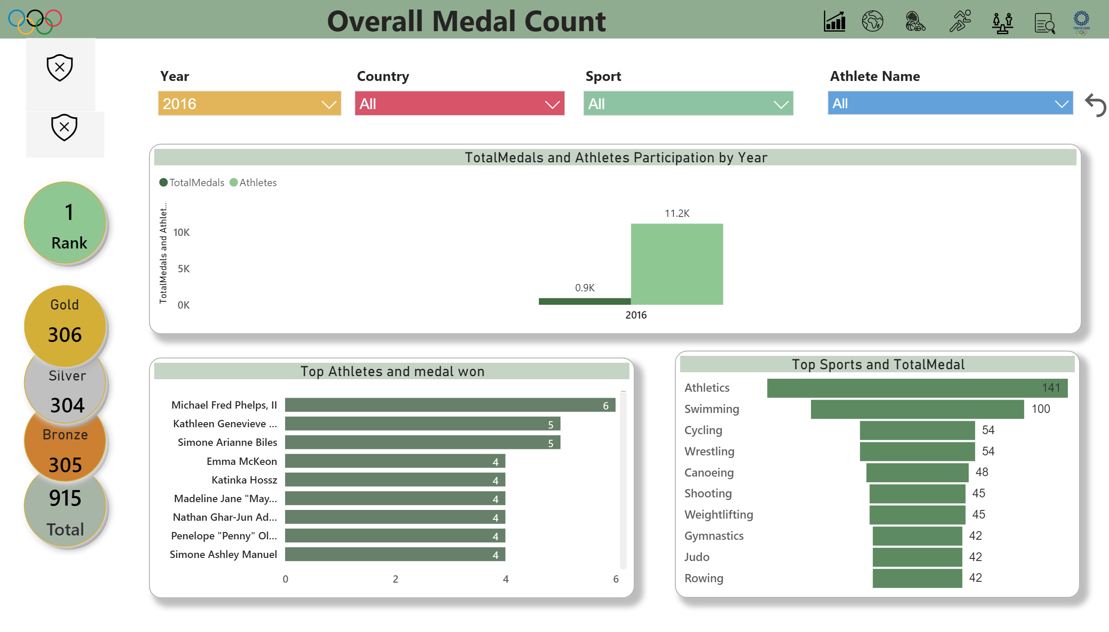
overall view
Notes:
slicer
No alt text provided.
slicer
No alt text provided.
slicer
No alt text provided.
slicer
No alt text provided.
shape
No alt text provided.
Gold
No alt text provided.
shape
No alt text provided.
Bronze
No alt text provided.
shape
No alt text provided.
Silver
No alt text provided.
Top Sports and TotalMedal
No alt text provided.
TotalMedals and Athletes Participation by Year
No alt text provided.
shape
No alt text provided.
card
No alt text provided.
Top Athletes and medal won
No alt text provided.
Image5
No alt text provided.
Image6
No alt text provided.
Image4
No alt text provided.
Image2
No alt text provided.
shape
No alt text provided.
card
No alt text provided.
ImgViewerVisual1455487926945
No alt text provided.
Image3
No alt text provided.
image
No alt text provided.
Imageolympics
No alt text provided.
textbox
No alt text provided.
image
No alt text provided.
Overall Medal Count
No alt text provided.
actionButton
No alt text provided.
ImgViewerVisual1455487926945
No alt text provided.

Slide 9
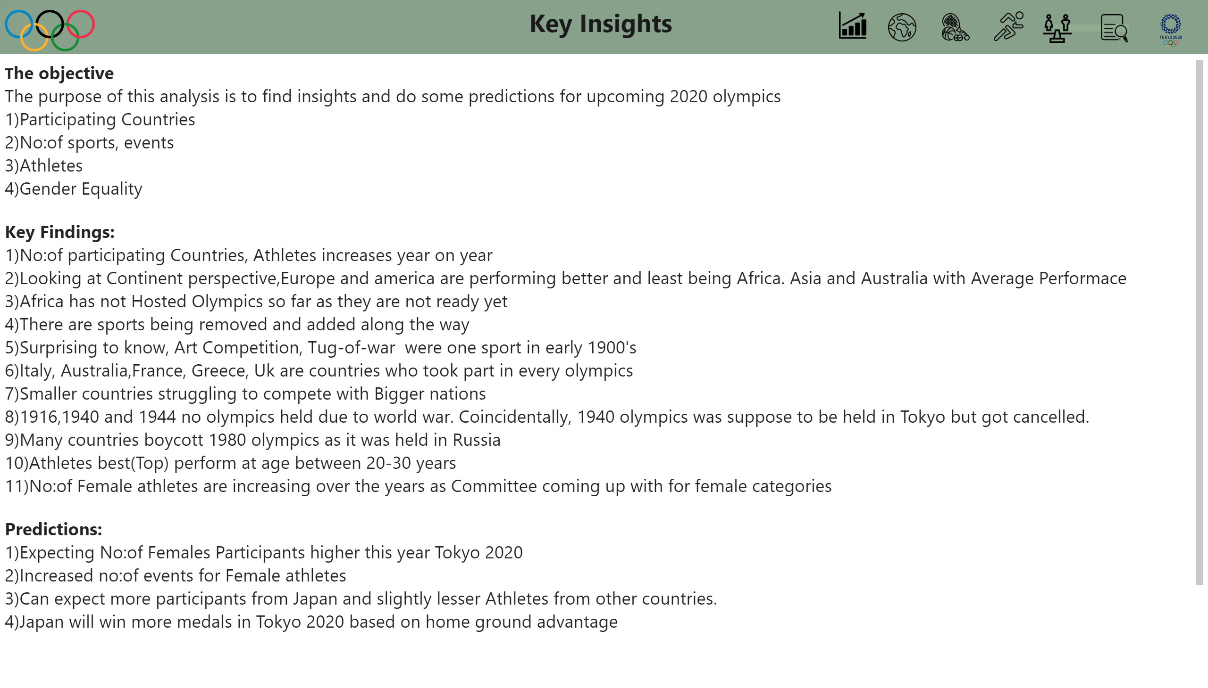
Key Insights
Notes:
shape
No alt text provided.
Image5
No alt text provided.
Image6
No alt text provided.
Image4
No alt text provided.
Image2
No alt text provided.
Image3
No alt text provided.
image
No alt text provided.
Imageolympics
No alt text provided.
textbox
No alt text provided.
image
No alt text provided.
textbox
No alt text provided.

Slide 10
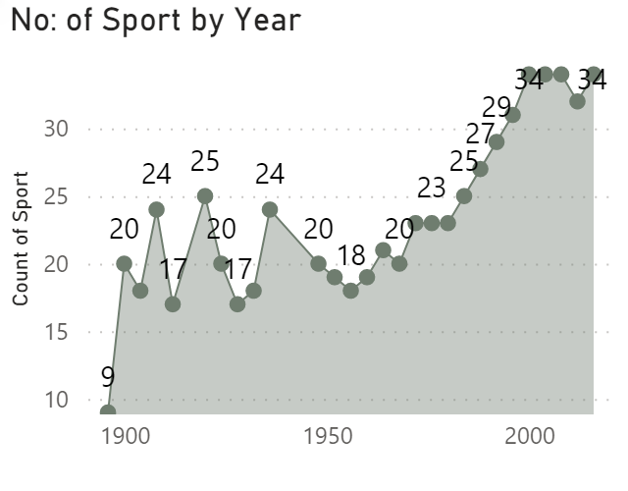
TTNsports
Notes:
No: of Sport by Year
No alt text provided.

Slide 11
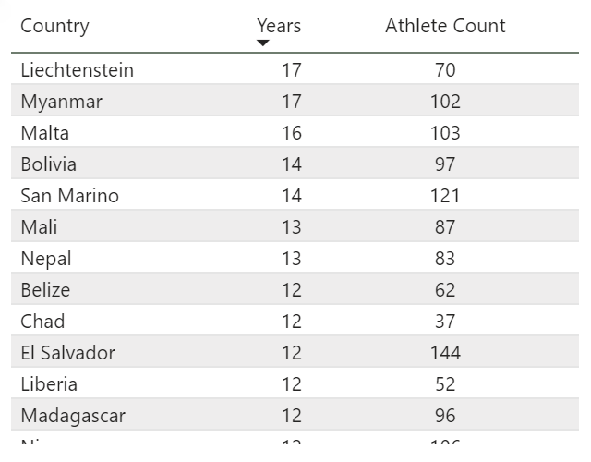
TTCountry
Notes:
No:of Times Participated
No alt text provided.

Slide 12
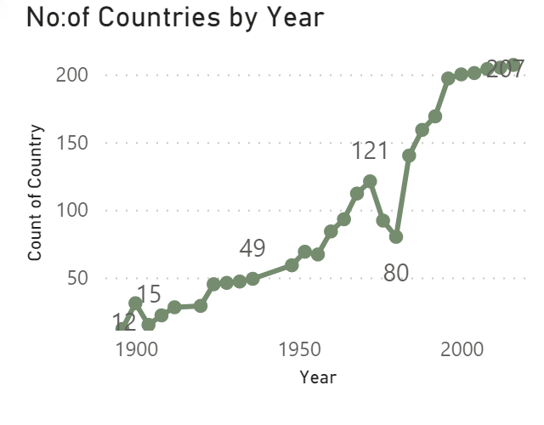
TTcountries
Notes:
No:of Countries by Year
No alt text provided.

